Slide 1


IDS 1721
Computing and Problem Solving for STEM
Chapter 07
The second Dimension
Lesson 01

Slide 2
Review
A two-dimensional (2D) array, often referred to as a matrix, is a rectangular array of numbers arranged in rows and columns.
In MATLAB, 2D arrays are a fundamental way to store and manipulate data.

Slide 3
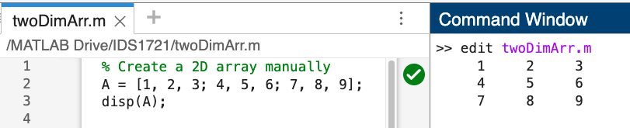
Recall: Creating Two-Dimensional Arrays
You can create a 2D array by specifying elements row by row, separating rows with semicolons (;).

Slide 4
Recall: Accessing elements
You can access elements of a 2D array using indices:
Single Element:
>> element = A(2, 3); % Access element at row 2, column 3
Entire Row:
>> row2 = A(2, :); % Access the second row
Entire Column:
>> column3 = A(:, 3); % Access the third column

Slide 5
Recall: Modifying 2D array
You can modify elements or parts of a 2D array by assigning new values.
Example:
>> A(1, 1) = 10; % Change element in first row, first column
>> A(2, :) = [11, 12, 13]; % Replace the second row
>> A(:, 3) = [14; 15; 16]; % Replace the third column
>> disp(A);

Slide 6
Recall: Basic operations
Addition and Subtraction:
>> B = A + 5; % Add 5 to every element
Matrix Multiplication:
>> C = A * B; % Ensure dimensions match
Element-wise Operations:
>> D = A .* B; % Element-wise multiplication

Slide 7
Common functions
Finding Size:
>> [rows, cols] = size(A); % Returns the number of rows and columns
Transposing:
>> A_T = A'; % Transpose rows and columns
Sum of Elements:
>> total = sum(A, 'all'); % Sum all elements
>> row_sums = sum(A, 2); % Sum each row
>> column_sums = sum(A, 1); % Sum each column
Finding Maximum/Minimum:
>> max_val = max(A, [], 'all'); % Maximum value in the entire array

Slide 8
Reshaping
>> B = reshape(A, 1, []); % Reshape into a 1D array
Concatenation:
>> C = [A, A]; % Horizontal concatenation
>> D = [A; A]; % Vertical concatenation

Slide 9
Visualizing 2D Arrays
We can visualize 2D arrays using various MATLAB plotting functions:
Heatmap:
>> heatmap(A);
Surface Plot:
>> surf(A);

Slide 10
Exercise 1
Create a 4×5 array of random integers between 1 and 20.
Replace all elements in the third row with zeros.
Calculate the sum of each column.
Transpose the array and display it.
Create a surface plot.

Slide 11
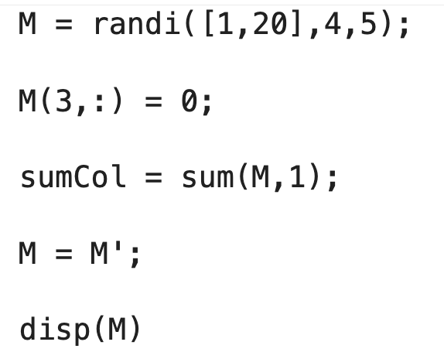

Slide 12
Exercise 2
Create a matrix C of random integers between 10 and 50 for a chosen size of your own.
Find and replace all even numbers in C with their square roots.
Replace all odd numbers in C with zeros.
Display the updated matrix.

Slide 13
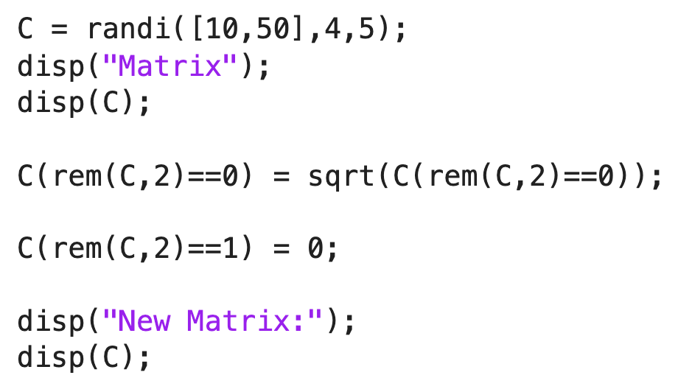
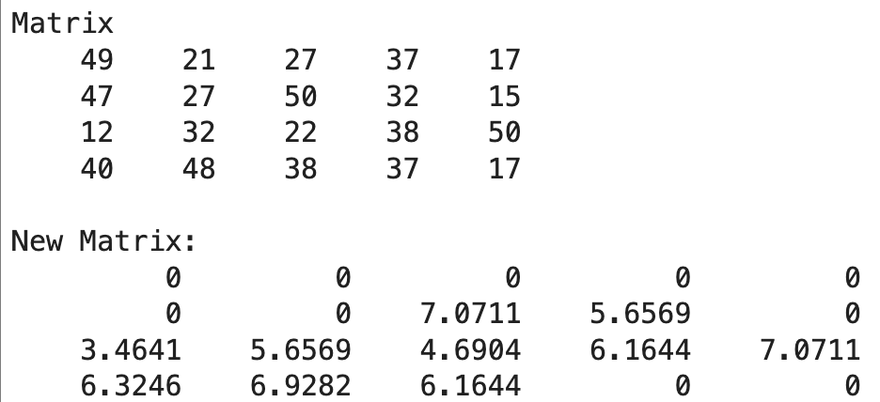

Slide 14
Grayscale Images
A grayscale image is an image where each pixel intensity represents a shade of gray, ranging from black to white.
The intensity values are typically stored as numerical values in a 2D matrix, where:
  Each matrix element corresponds to a pixel in the image.
  Values range from 0 (black) to 255 (white) for 8-bit images.
In MATLAB, grayscale images are represented as 2D arrays (or matrices).
Example:
>> I = imread('cameraman.tif');
This will store the above image as a matrix from MATLAB library.

Slide 15

Display the image
You can display the image using the following command
>> imshow(I)
Save a copy of the image using
>> imwrite(I,'cameraman.jpg')

Slide 16
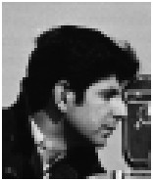
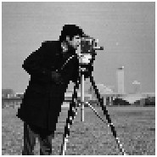
Exercise 3
To the matrix in the previous exercise apply the following commands and observe what they do.
>> I1=I(:,3);
>> imshow(I1)
>> I2=I(5,:);
>> imshow(I2)
>> I3=I(30:90,90:140);
>> imshow(I3)
>> I4=I(1:3:end, 1:3:end);
>> imshow(I4)
>> I5=I(end:-1:1, end:-1:1);
>> imshow(I5)
>> B=I’;
>> imshow(B);
>> C=I;
>> C(:,4) = 0;
>> imshow(C)

Slide 17
Exercise 4
In this task consider the image 'cameraman.jpg' and apply the following transformations.
Reflection of the original image with respect to its middle vertical axis.
Reflection with respect to its middle horizontal axis.
Reflection about the origin.
Rotate the image anticlockwise by 90 degrees..
Rotate the image by 180 degrees.

Slide 18
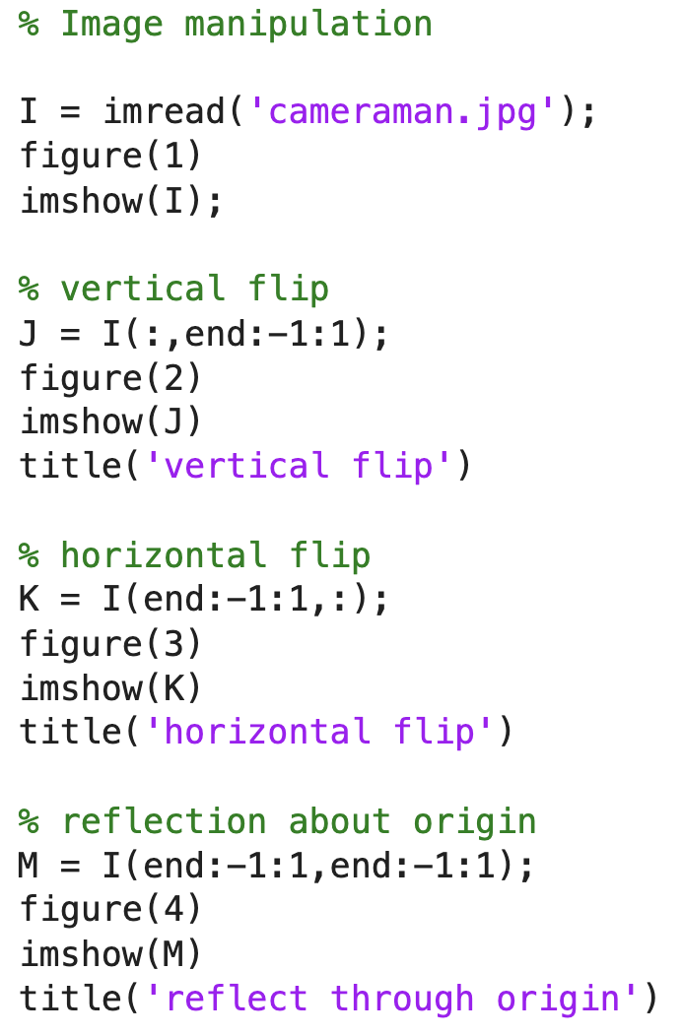
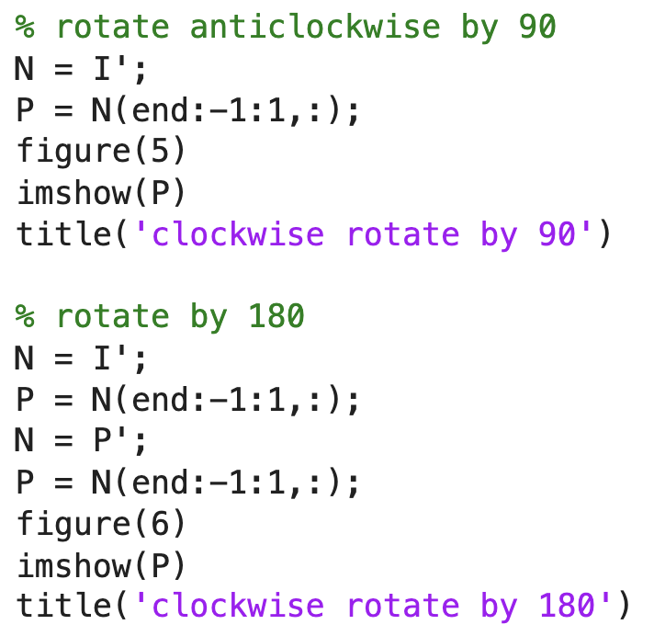

Slide 19
Surface plot
In MATLAB we can visualize 3D data through surface plotting.
Steps
Create the grid of x and y values using meshgrid.
Calculate Z based on the given function.
Plot the surface using surf.
Customize the appearance of the surface plot.
Optionally, include additional visualizations such as contour3 or mesh.

Slide 20
Exercise 5
Create a grid of x and y values using meshgrid over the range −10≤x≤10 and −10≤y≤10, with a step size of 0.5.
Create a matrix Z that represents the surface heights, using the function:
Z=sin⁡(X) + sin(Y)
Plot the Surface:
  Use surf to create a surface plot of Z.
  Label the axes, add a title, and include a color bar.
Customize the Plot
  Add axis labels for x, y, and z.
Display the same data using the mesh function for comparison.

Slide 21
